Slide 1
Advanced Housing Regression
-Ketan Sethi

Slide 2
Problem Statement :
Ask a home buyer to describe their dream house, and they probably won't begin with the height of the basement ceiling or the proximity to an east-west railroad. And that leads to construction of this Problem Statement and utilization of this dataset which may prove that much more influences price negotiations than the number of bedrooms or a white-picket fence.
For the given Dataset :
Predict the Sales Price for the unseen data
Analyze and provide the most dependent features
Handle Missing values
Feature Dependence
Sales Price Prediction
Housing Sales Price Dataset

Slide 3
Approach
I will start the entire solution by just describing my approach to the problem and how I will proceed with different parts of the problem statement.
For my understanding I have partitioned my approach in 3 parts
Data Exploration
Mathematical Modelling(Machine Learning Techniques)
Model Selection & Prediction

Slide 4
Data Train
Data Train
Feature Analysis
Outlier Removal
Feature Engineering
Full Data
Full Data
Data Exploration
Data Test
Most Dependent Feature Prediction
Missing Value Imputation
Data Test
Training Data(70%)
Machine Learning Model Creation
Ensemble Model Creation
Data Train
Train on full Data
Mathematical Modelling
Validation Data(30%)
Validation on Val Dataset
Data Test
Use the model to predict Prices
Obtain the best features
Compare with the features from data exploration
Present Results
Prediction

Slide 5
Data Exploration

Slide 6
Data Exploration :
Feature Analysis & Exploration
Sales-price
Overall Condition
Year Built
Lot Area
Type of Roof
Fireplace
Basement Area
Basement Height
Heating Type
Number of Bedrooms
Pool Area
Garage Quality
Garage Area
Dataset:
The Dataset is divided in two parts Training and Testing
Both dataset contain 79 features excluding Sales Price and Id of each sample and 1460 instances
The dataset contain 43 Categorical variables and 26 numerical variables
The data is not normalized and there is a lot of variation in the features scales
Few of the features of the dataset are depicted in the figure on the left

Slide 7
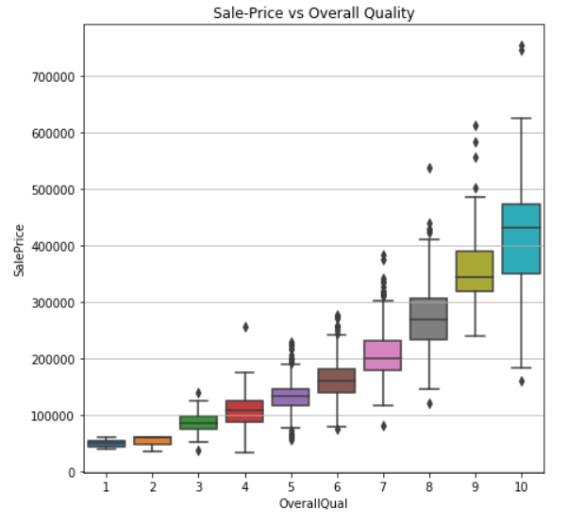
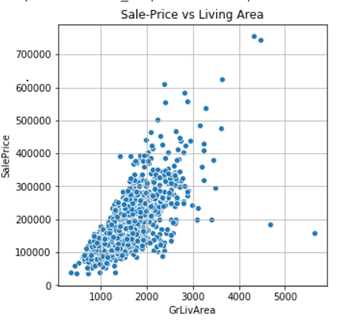
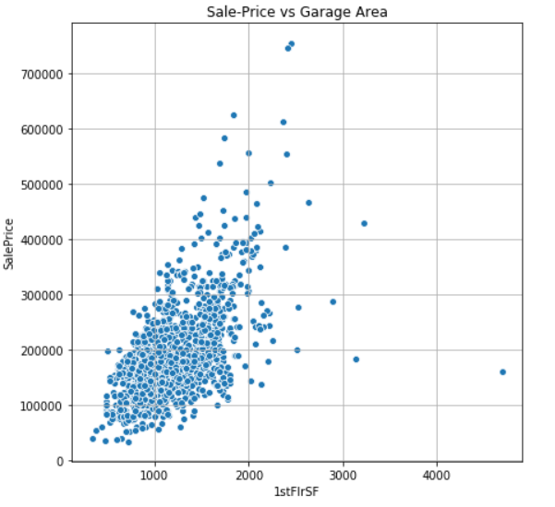
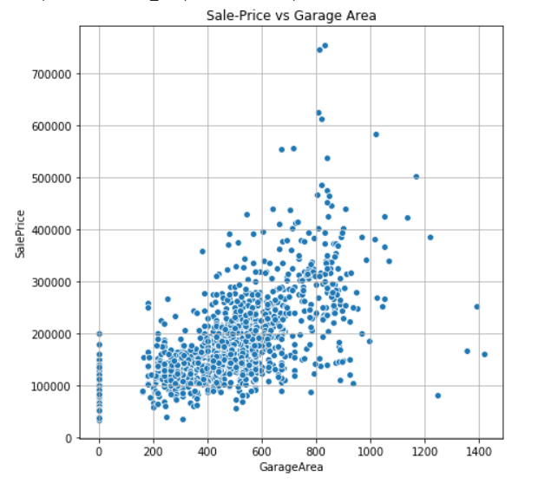
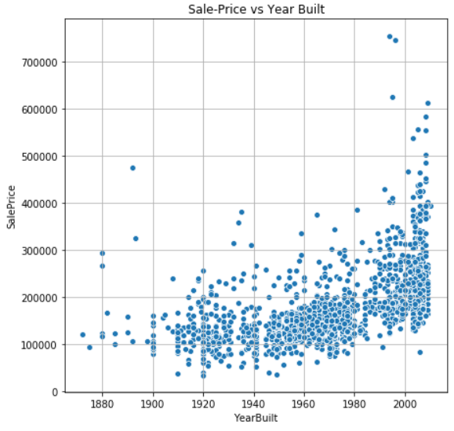
Data Exploration :
Most Dependent Features
In the coming slide we will explore data to find relationships between our dependent variable and our prediction terms
Objectives-:
To find the most dependent variables
The most dependent features are those which may show linear dependence
For the data exploration I have used “matplotlib” and “seaborn”
Overall Quality vs Sales Price
Living Area vs Sales Price
First Floor Area vs Sales Price
Garage Area vs Sales Price
Year Built vs Sales Price

Slide 8
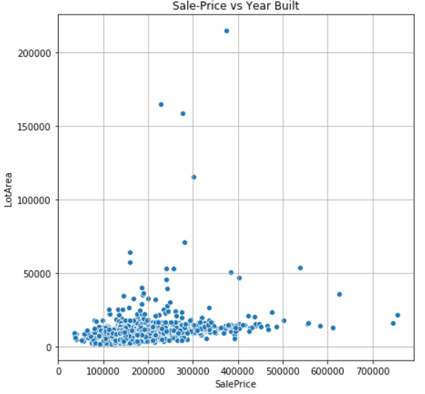
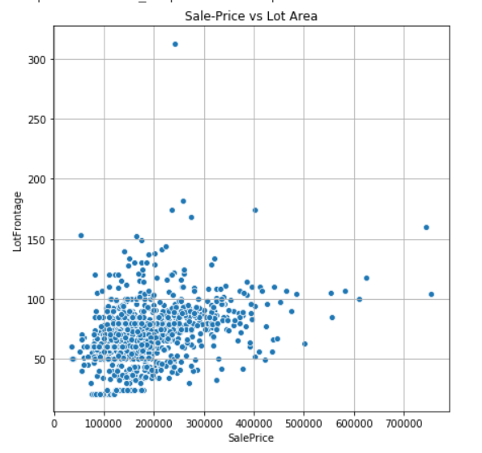
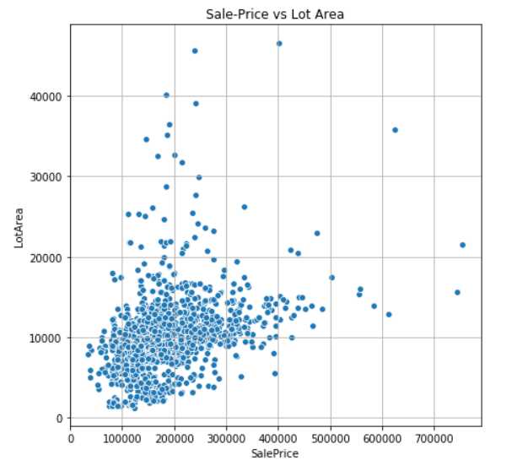
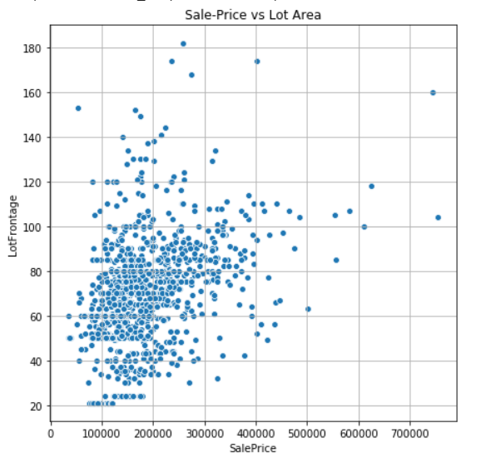
Data Exploration : Outlier Identification and Removal
Outliers are data points which are situated away from the main cluster of points for that feature ,
Objectives-:
To plot each feature and find points that are far away from clusters
To remove outliers and plot features again to observe the difference
For the data exploration I have used “matplotlib” and “seaborn”
Lot Frontage
Lot Area
With Outlier
After Removal
With Outlier
After Removal

Slide 9
Data Exploration : Handling Missing values
For Features missing values more than 50%. We will try and get more data and if that is not possible we will drop those features because we won’t be able to extract much information from them
Feature Engineering Methods applied:
Predicting missing features by modelling non missing features but using different models to prevent “over-fitting”
Taking mean , median ,mode depending on the feature
Finding dependence of the feature on other features and taking mean , median or mode while taking into consideration the dependent features

Slide 10
Handling Missing values : Approach Analysis
Handling Missing Values
Value Replacement by Feature Mean/Mode/Median
Value prediction by Modelling
Finding Relation with other features and relative mean/mode/median imputation

Slide 11
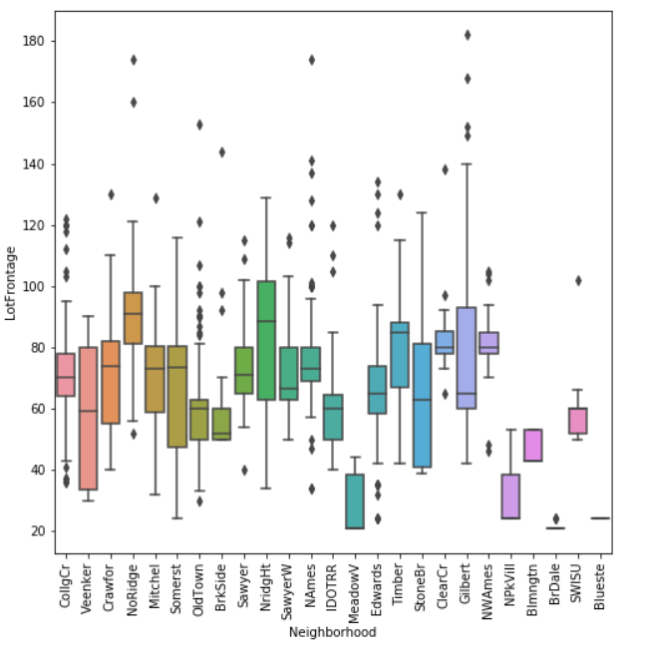
Approach 3 explanation
The approach of replacing the “NaN” values with mean of the feature, underperformed as expected due to the dependence of the feature on other features
First I individually checked ‘Lot-Frontage’ relationship with every other variable and came to conclusion that ‘Lot-Frontage’ was mostly dependent on “Neighborhood” which makes sense logically also
Depending on the “Neighborhood” I developed a box-plot to view the mean fluctuation with different types of neighborhood
Final step is to replace the null values with these individual means

Slide 12
Statistical Machine Learning

Slide 13
Statistical Machine Learning : Explanation
Rather then explaining each model individually I have implemented few Regressive models and have plotted the results in the next side
As we will be able to see in the coming slide that “Non Linear models” like Random Forest, Gradient Boosting tend to perform well on training data but underperform on Validation data indicating “overfitting”
To attain accuracy I decided to use “ensemble models” to achieve accuracy closer to Non linear models and less “overfitting” due to the linear component
I have experimented with many iterations and I will be showing the best results from all the iterations

Slide 14
Statistical Machine Learning : Results

Slide 15
Statistical Machine Learning: Ensemble model
Gradient Boost: Performed way better than linear models on training data but underperformed on validation data hence weightage reduced to 60% of the Ensemble model
Random Forest : The model performs good on training data and has low chances of “over-fitting” due to the randomization in algorithm
Lasso: The model is used to provide linearity and reduce overfitting and hence the weightage given is as high as 30%
The model performs well on training data and also performs better than all models on test data

Slide 16
Conclusion

Slide 17
Conclusion: Feature Importance
While exploring data we made some predictions regarding the best features and now we use statistical machine learning to attain the most dependent features.
The features attained through machine learning models are similar to what we predicted and hence giving strong evidence in support to our hypothesis

